Slide 1

MIS 776 Business Analytics
Presented by Michael J Lee, PhD

Slide 2

Model Fit, Overfit & Tuning

Slide 3

Class Business
Reading for this week is Provost Chapter 4, 5, and 7.
I have enabled self-signup for the project groups. Please note the following:
Group size is 3 students. I may expand this to 4, but for right now let's leave this at 3
If you are not signed up in a group by Sunday, September 22 at 11:59 PM, I will start placing you into open groups.
If you are on the research or competition path, you do not need to sign up. I have already placed you into groups.
There is no coding assignment for this week. Focus on getting your group membership in place and then start thinking about possible data sets.

Slide 4
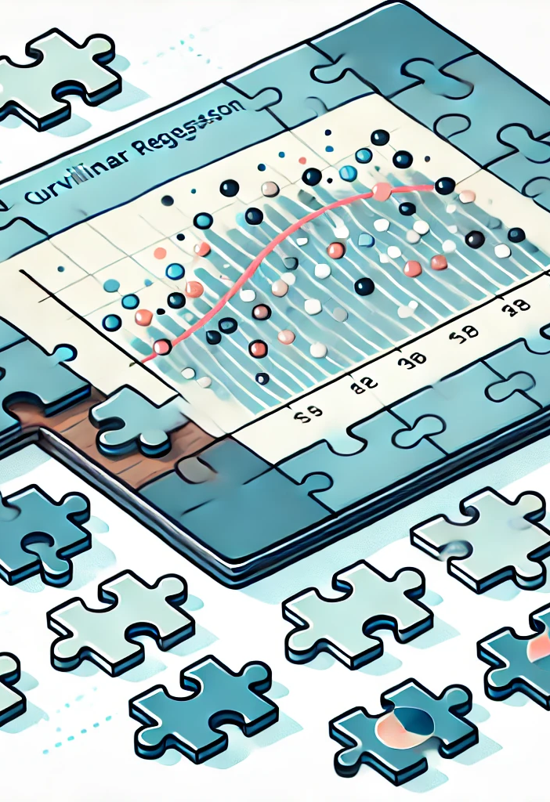
Session Topics
Identifying Model fit
Recognizing and managing overfit
Using hyperparameters to improve model fit

Slide 5

What is Model Fit?
Different data sets have varying distributions and features
Some models fit the data better than others
Problems such as outliers can impact interpretability
Therefore, we must have a way of measuring how well the model actually fits the data

Slide 6

Example: Linear Regression
We can evaluate important metrics such as:
Omnibus F Test: Is the model significant overall?
Feature P-value: Does the feature contribute significantly to the model?
R-squared: How much of the variance in the dependent variable can be explained by the model?

Slide 7
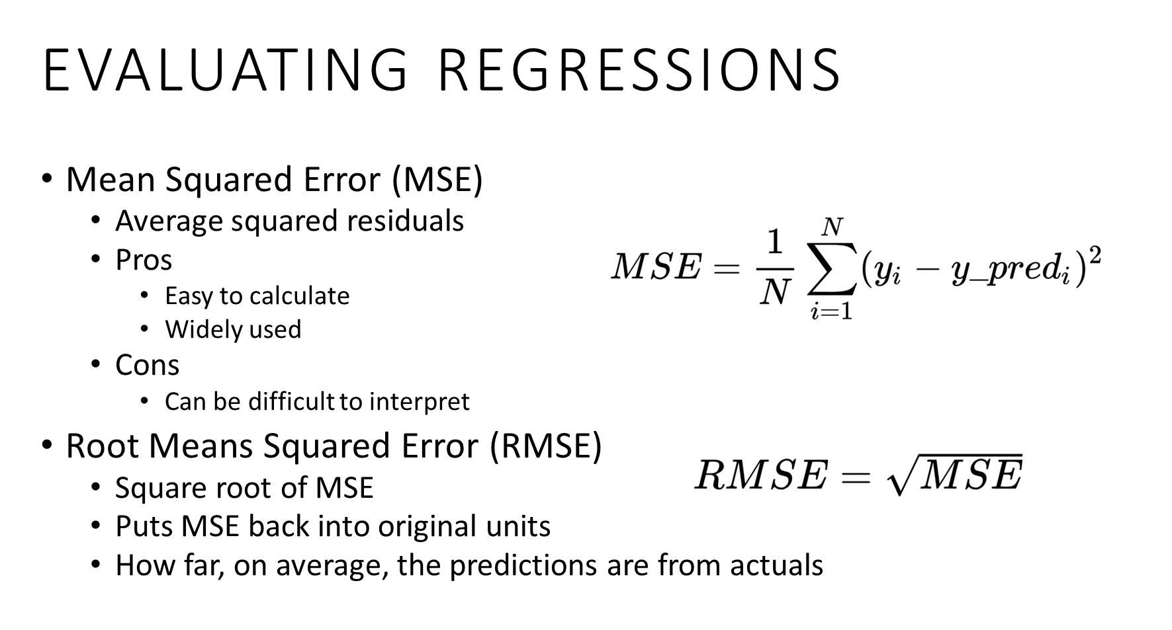

Slide 8
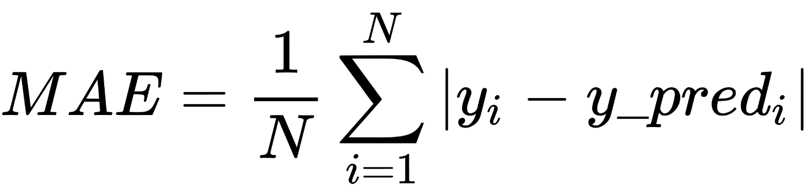
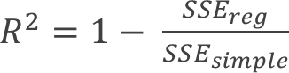
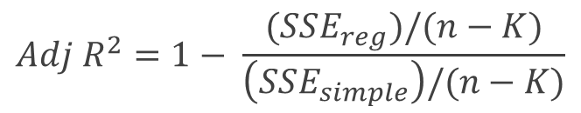
Evaluating Regressions (cont.)
Mean Absolute Error
The average of the absolute values of deviations
Easy to interpret
Easy to calculate
R-Squared
Sometimes called “coefficient of determination”
Interpreted as
Percent of variance explained by the model as compared to default model
Adjusted R-Squared
Same Interpretation as R²
Includes penalty for adding predictors
$${Adj R}^{2}=1− \frac{(SSE_{reg})/(n−K)}{\left(SSE_{simple}\right)/(n−K)}$$

Slide 9
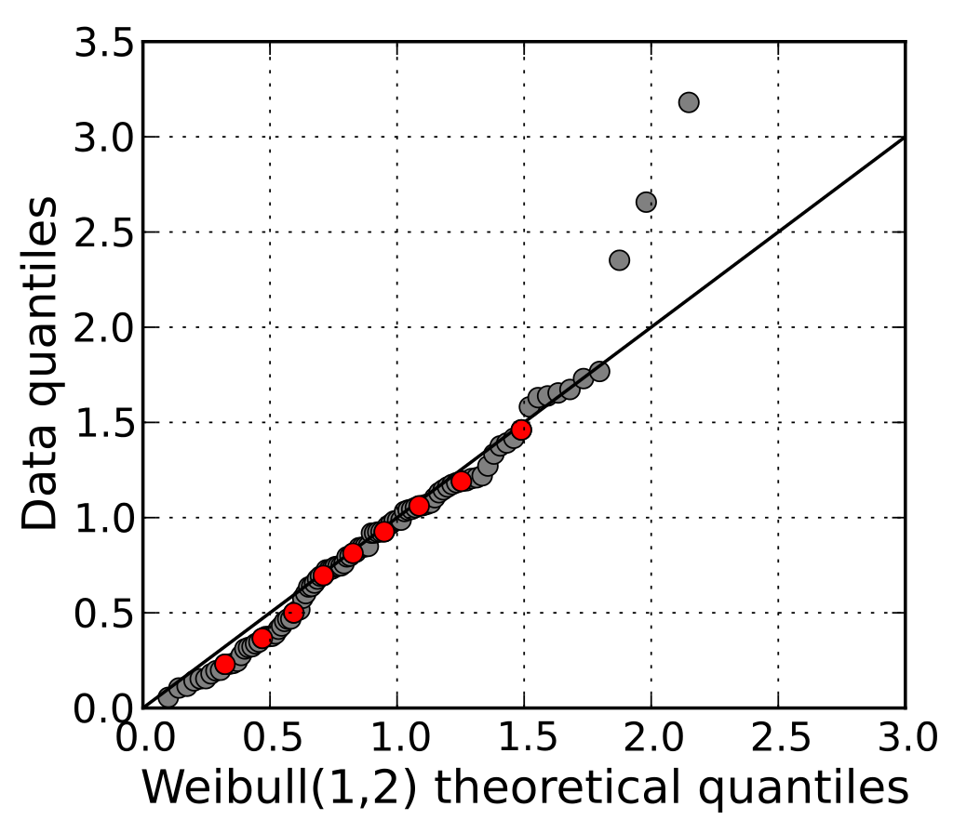
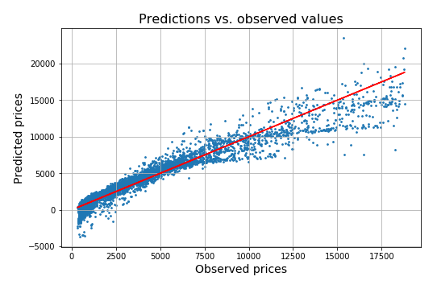
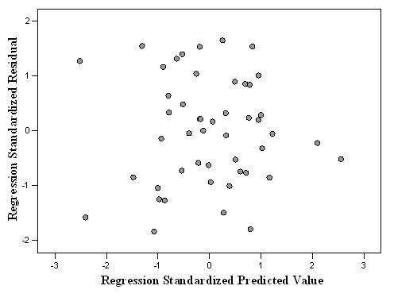
Evaluating Residuals
Normal distribution of residuals
Jarque-Bera Test
Evaluates skewness and kurtosis
Shapiro-Wilk Test
Evaluates if the sample comes from a normally distributed population
Graphical Tests
Quantile-Quantile (QQ) plot
Prediction versus Observed Plots
Homoscedasticity
Bartlett’s Test
If the ratio of the largest variance to smallest variance is 1.5 or below

Slide 10

Example: Classification
Classification models should be able to place similar objects in the same bucket
Accuracy can be measured by looking at what the model got right and what it got wrong
There are a variety of different evaluations metrics such as:
Accuracy
Precision
Recall
F-Measure
ROC Curves

Slide 11
Classifier Evaluation Measures
Confusion Matrix
D = aa+bb+ab+ba,
Actual a = (aa+ab), also Actual non-b
Actual b = (ba+bb), also Actual non-a
Classified a = (aa+ba), Classified b = (ab+bb)
 | Classified or Predicted
Actual |  | a | b
 | a | aa | ab
 | b | ba | bb

Slide 12

Classifier Evaluation Measures
Accuracy is the overall correctness of the model and is calculated as the sum of correct classifications divided by the total number of classifications.
Accuracy = (aa+bb) / D
True Positive Rate (a) = aa / Actual a
True Positive Rate (b) = bb / Actual b
False Positive Rate (a) = ba / Actual b
False Positive Rate (b) = ab / Actual a

Slide 13

Precision, Recall, and F-Measure
Precision
A measure of accuracy for a specific class.
Precision (a) = aa/ Classified a
Precision (b) = bb/ Classified b
Recall
A measure of the ability of a classification model to select instances of a certain class from a data set. It is commonly also called sensitivity.
Equivalent to TP rate.
Recall (a) = aa / Actual a
Recall (b) = bb/ Actual b
F-Measure
The F-measure is the harmonic mean of precision and recall.
It can be used as a single measure of performance of the test.
F = ( 2 x Precision x Recall ) / ( Precision + Recall )

Slide 14
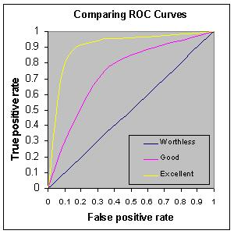
ROC Curves
Used for binary classifiers
Originated with radar analysis of signal vs noise
Plot of True Positive Rate (Recall) against False Positive Rate
The larger the Area Under the Curve (AUC), the better the discrimination of classification
Can monitor the relationship through the ranges of positives and negatives

Slide 15
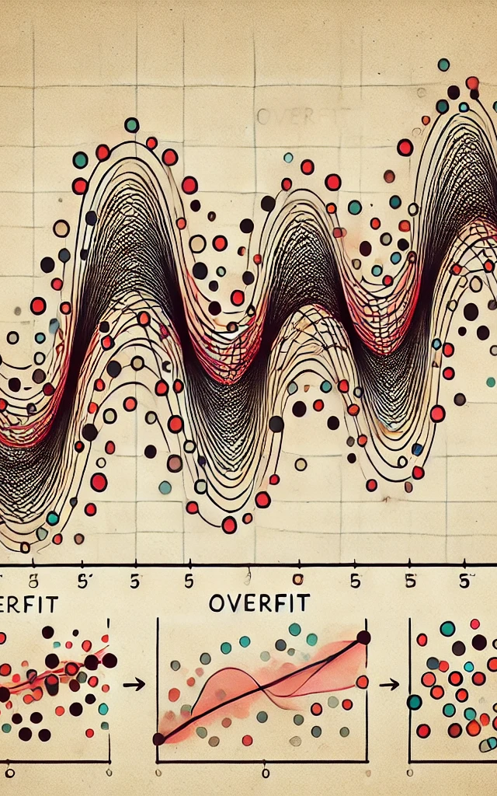
Evaluating Overfit
By separating the data set into a training and testing partition, we can generate a model using the training partition and evaluate the model with the testing holdout set
Overfit occurs when training accuracy is much higher than testing accuracy
This is often due to issues such as:
Inadequate validation procedures
Outliers in the data set
High model complexity
Random data distribution

Slide 16
General Modeling Process
Model training/learning/building
Data Collection
Pre-processing
Training Data
Classification algorithm
Rules (Patterns or Models)
Test Data
New Data
Model
testing
Model
application
Evaluate
Class
Prediction

Slide 17
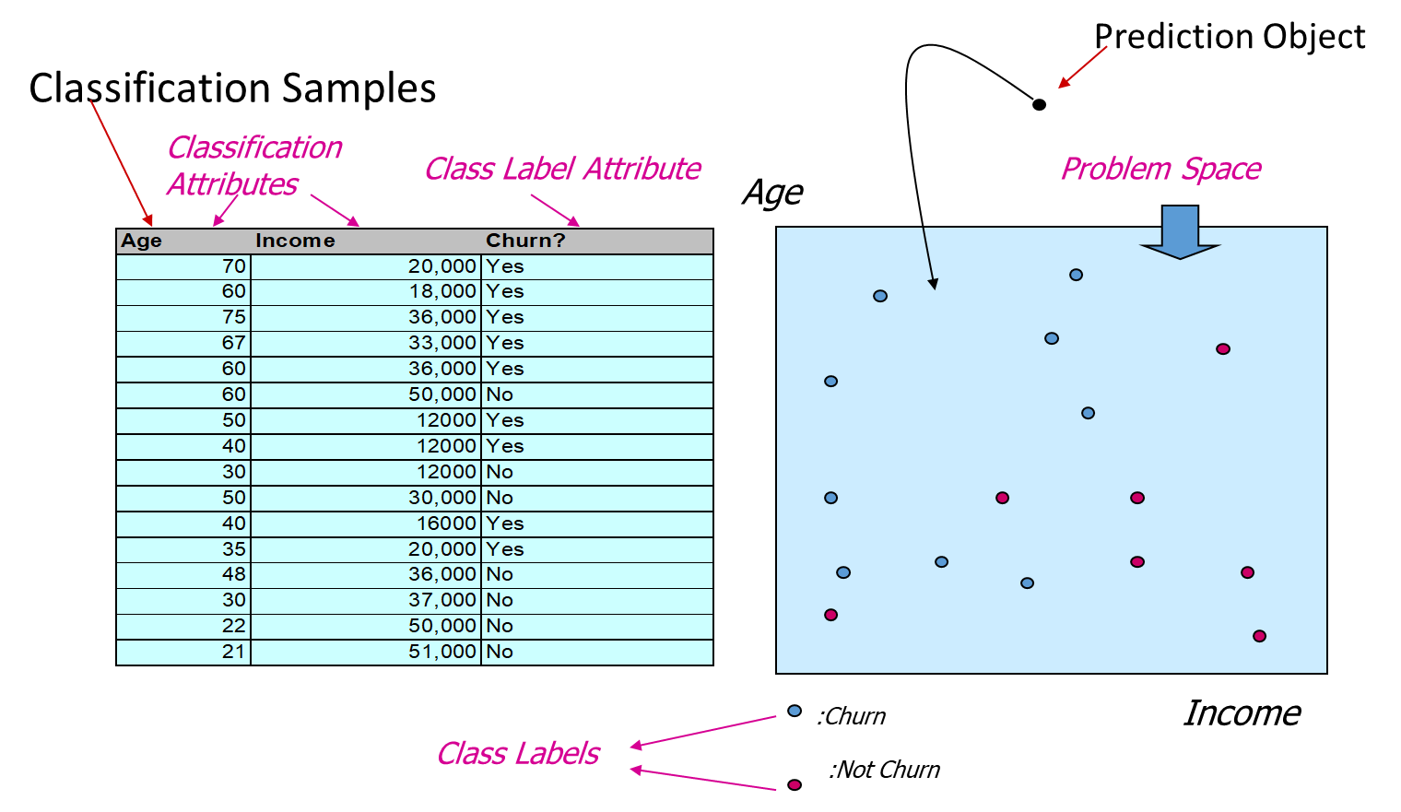
Decision Tree Classification Example

Slide 18
Decision Tree Classification Example
Mapping Principle: Recursively partition the data set so that the subsets contain “pure” data
Age
Churn
Not Churn
Income

Slide 19
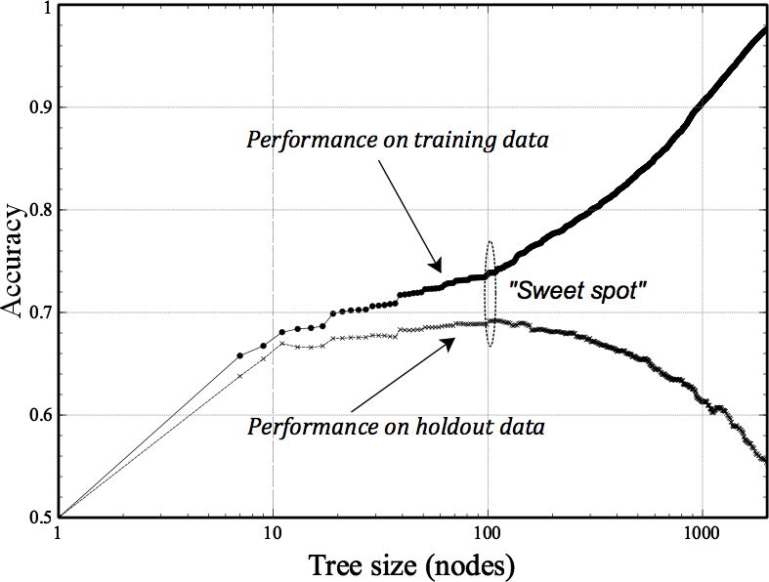
Overfit due to Model Complexity
One of the hyperparameters that we can control for a decision tree is the tree size.
Trees with a greater number of levels can get very complex
Setting the tree size in the “sweet spot” can minimize overfit

Slide 20
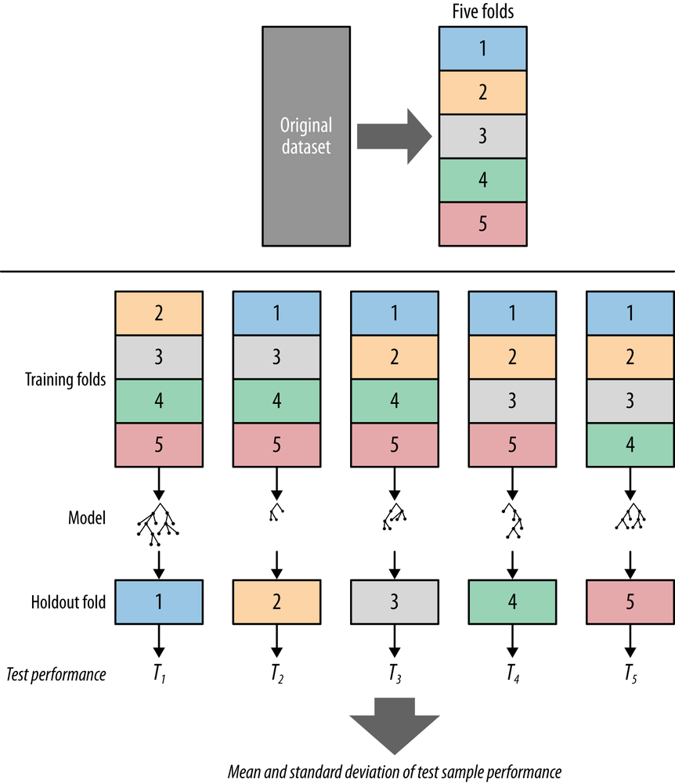
K-Fold Cross Validation
Useful for smaller data sets or when more rigorous validation is needed.
Alternative to train – test splitting
Every piece of data is used for both training and testing
If k = number of folds then
Each data point will be used for training k-1 times
Each data point will be used for testing 1 time

Slide 21
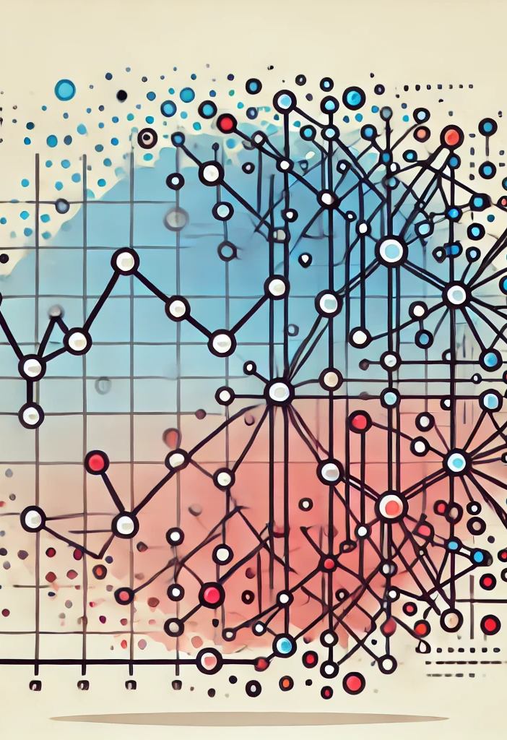
Solutions to overfitting
Evaluate multiple train – test splits to see if a different random seed results in a better data fit.
Try a K-Fold approach as alternative to a train-test split.
Evaluate different techniques to see if an alternate technique provides better results.
Use regularization techniques including:
Standardize feature units if the distributions are significantly different.
Select fewer but more significant features.
Reduce model complexity through hyperparameter tuning or by employing model complexity penalties.

Slide 22

Assignments for this week
Stay current on the reading
Provost Chapter 4, 5 & 7
Discussion 4
Reminder: Initial post due on Wednesday @ 11:59 PM
Follow-up posts due on Sunday @ 11:59 PM
No coding assignment this week
Start doing the self-signup for Project Groups

Slide 23

Questions?
Contact me via Web Campus
Or email at:
michael.j.lee@unlv.edu

